Slide 1
FLYAWAY Project from Simplilearn Phase2
Description of the project
======================
FlyAway is the ticket booking portal that allows people to book flights on their websites
GitHub link:- https://github.com/UdayBoppapuram/Flyaway

Slide 2
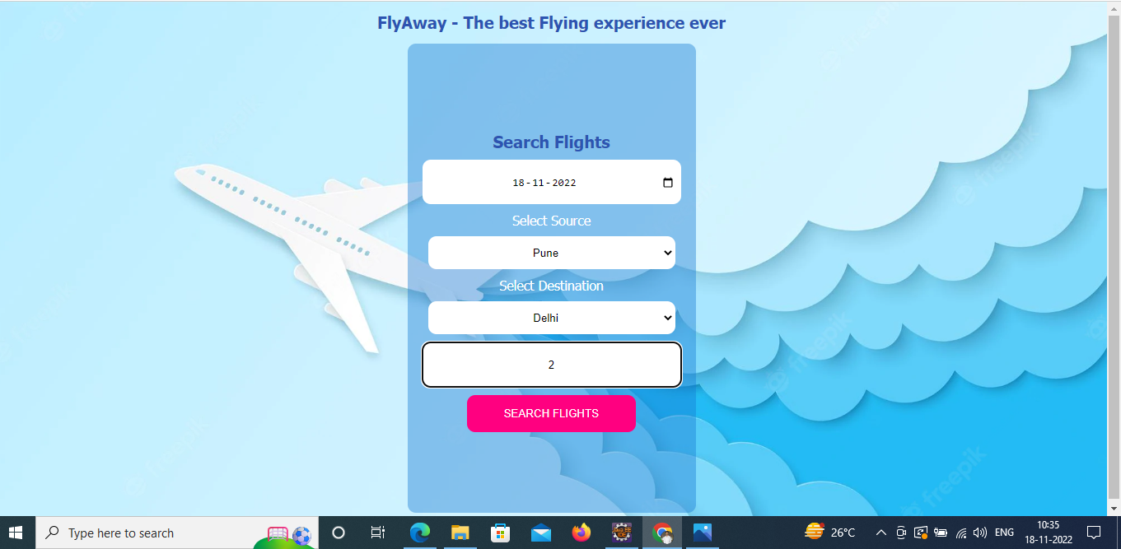
Concepts used : Softwares :
Hibernate and Java MVC model Eclipse IDE , MySql
Project Screenshots:
Passenger’s UI

Slide 3
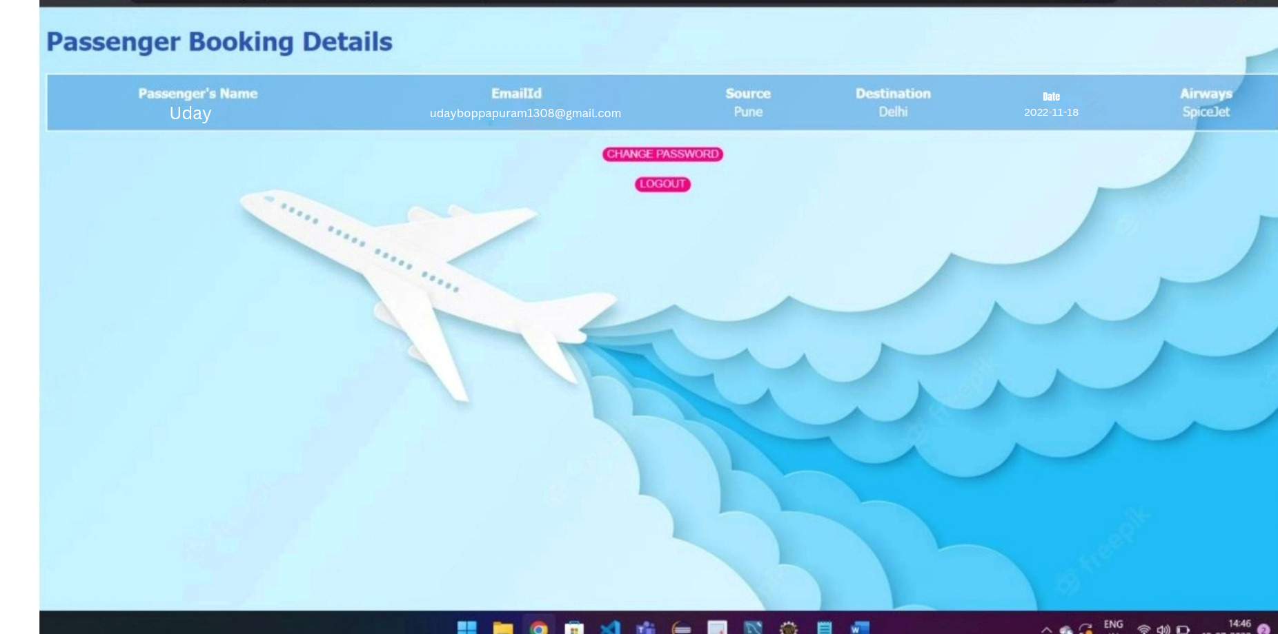
Showing the flights available for required fields

Slide 4
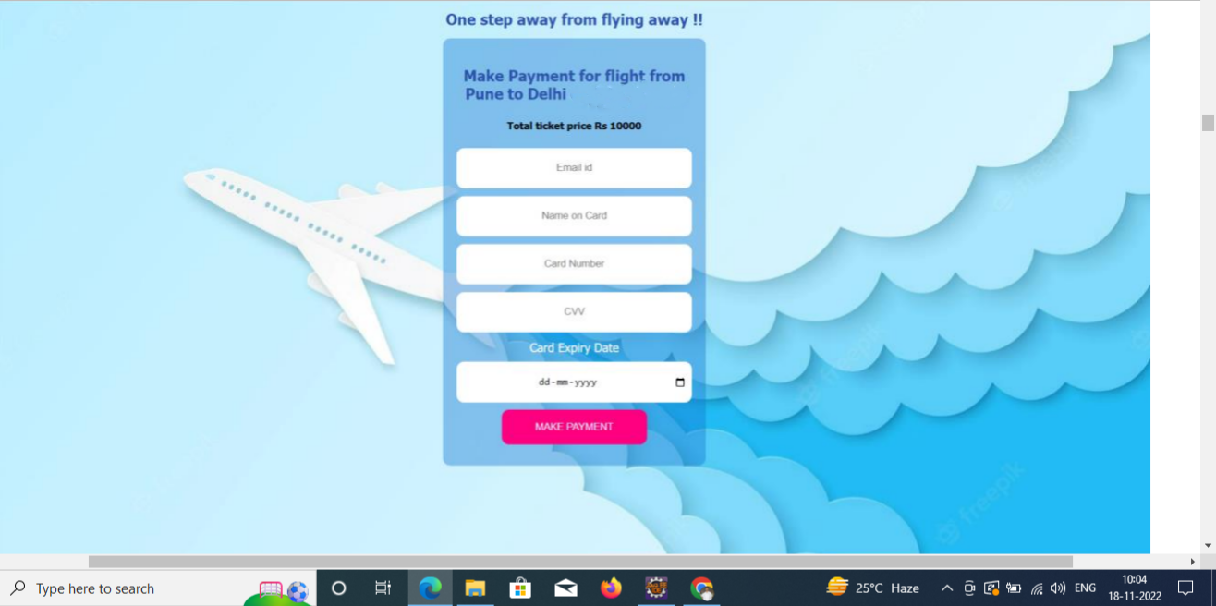
On Clicking Proceed to Pay Payment page is displayed

Slide 5
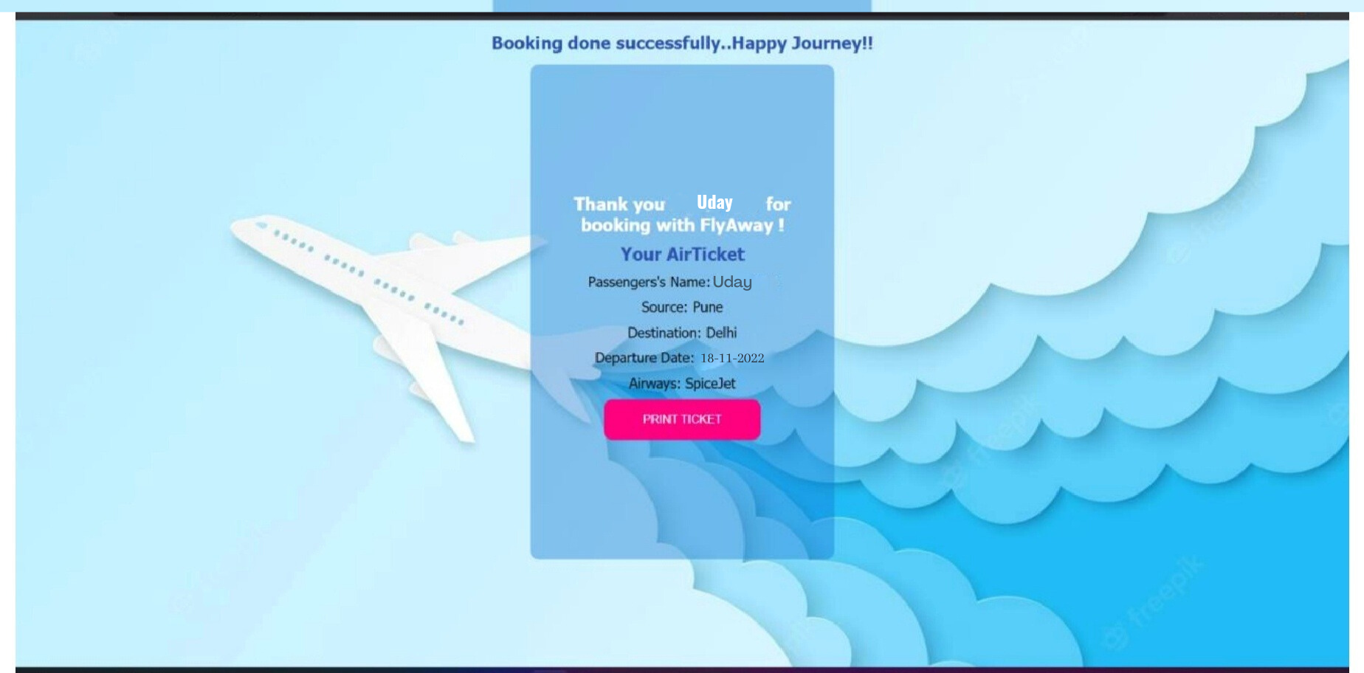
Booking successful page reflets like:

Slide 6
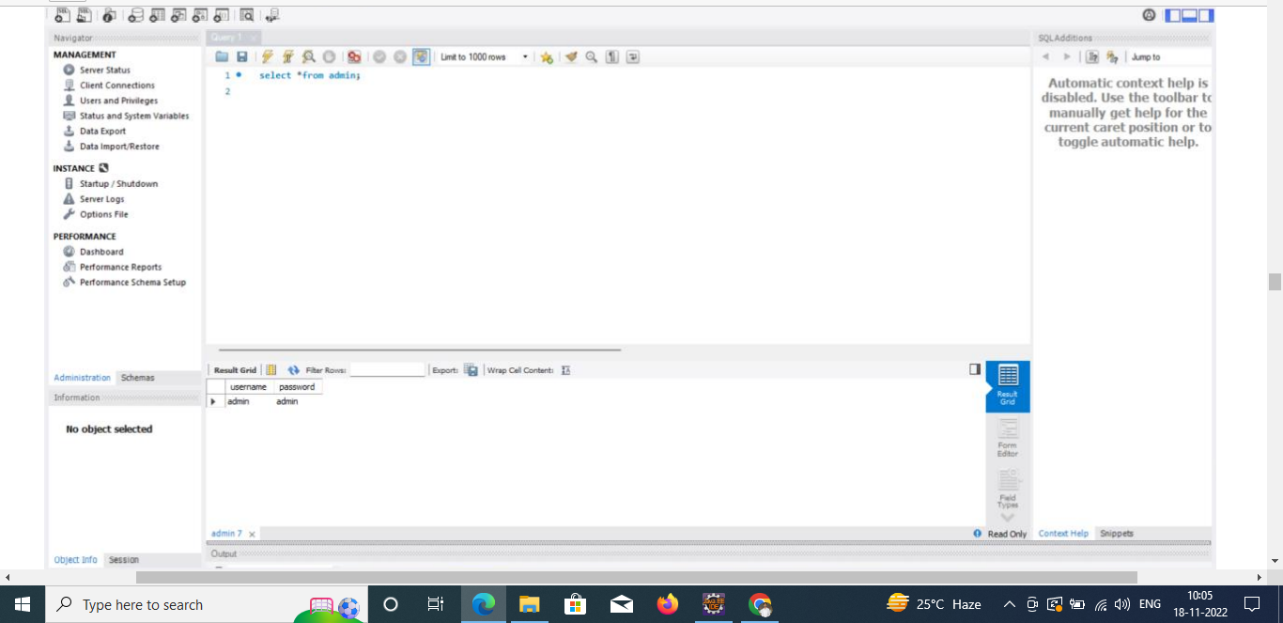
Admin’s UI : Database 1: To Store Username and Password

Slide 7
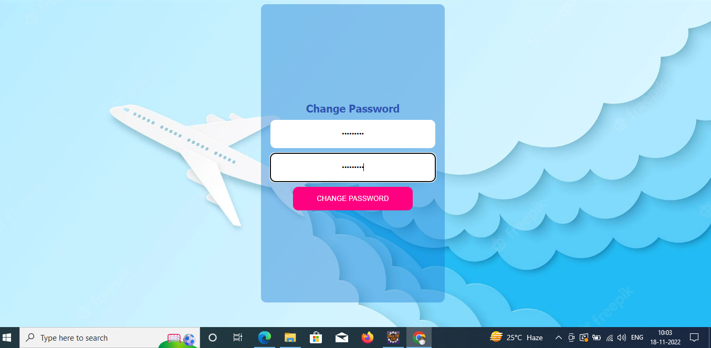
PASSWORD CHANGE:

Slide 8
After Login :
The details of booking done above are created in a table and shown to admin

Slide 9
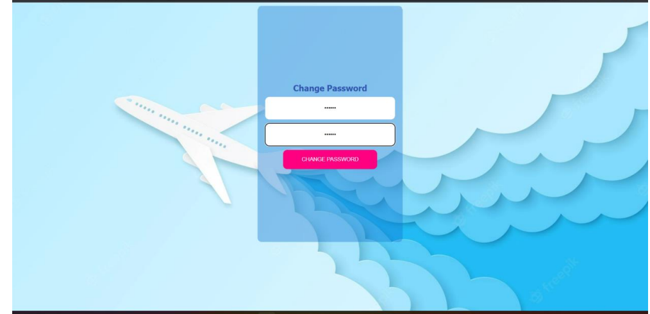
I am changing password from “admin” to “qwerty

Slide 10
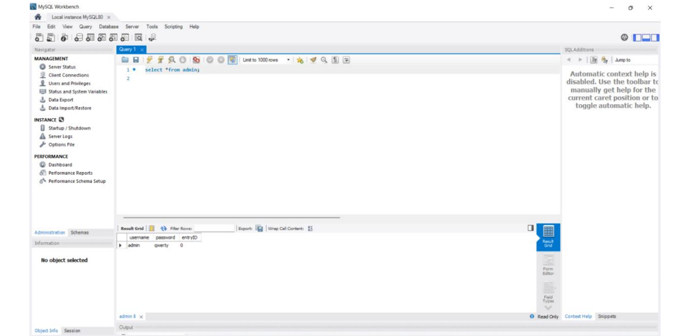
Password change reflected in database for next admin login !!

Slide 11
THANK YOU

